Slide 1
Randomized Testing of Distributed Systems
Burcu Kulahcioglu Ozkan
Concurrency Theory, 20/01/2020
TU Kaiserslautern

Slide 2
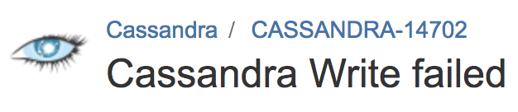

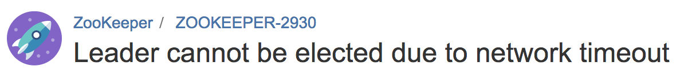
Recap - Distributed systems are prone to bugs!
Distribution
Asynchrony
Replication
…
They are difficult to test!
Many components, many sources of nondeterminism

Slide 3
How to detect bugs?
. . . . . . . .
. . . . . . . . .
. . . . . . . . . . . . . . . . . . . . . . . . .
. . . . . . . .
. . . . . . . .
. . . . . . . . . . .
. . . . . . . . . . .
Systematic testing - infeasible
Random testing – no guarantees
Randomized scheduling algorithms:
With theoretical a lower bound on the probability of exposing a bug
(joint work with Rupak Majumdar, Filip Niksic, Simin Oraee, Mitra Tabaei Befrouei, Georg Weissenbacher)

Slide 4
PCT(CP) on an example
Handler
Logger
Terminator
Upgrowing Poset:
Request
Log
Request
Terminate
Log
Terminate
Buggy if:
Flush executes before Log!
Flush
Flush
Flushed
Flushed
Online chain partitioning:
The program is decomposed into causally dependent chains of events:
$$C1= \left[Request, Log\right]$$
$$C2= \left[Terminate, Flush\right]$$
$$C1= \left[Request\right]$$
$$C1= \left[Request, Log\right]$$
$$C2= \left[Terminate\right]$$
$$C1= \left[Request, Log\right]$$
$$C2= \left[Terminate, Flush, Flushed\right]$$
$$priority(C1) > priority (C2)$$

Slide 5
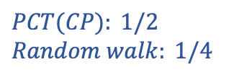
PCT(CP) on an example
Handler
Logger
Terminator
Upgrowing Poset:
Request
Log
Request
Terminate
Log
Terminate
Buggy if:
Flush executes before Log!
Flush
Flush
Flushed
Flushed
Online chain partitioning:
The bug is detected with probability:
$$C1= \left[Request, Log\right]$$
$$C2= \left[Terminate, Flush, Flushed\right]$$
$$PCT(CP): 1/2$$
$$Random walk: 1/4$$
$$priority(C2) > priority (C1)$$

Slide 6



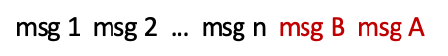
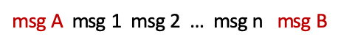
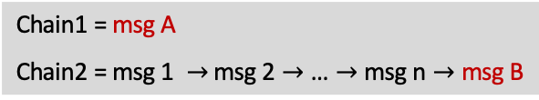
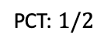
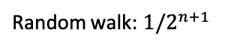
Random Walk vs PCT(CP)
Node 1
Node 2
PCT’s probabilistic guarantee is based on:
msg A
msg 1
Online chain partitioning
msg 2
$$\text{C}\text{hain}\text{1 = }\text{msg} \text{A}$$
$\text{C}\text{hain}\text{2 = }\text{msg}\text{ 1 }→$ $\text{msg}\text{ 2}→\text{…}→\text{msg} \text{n}→\text{msg} \text{B}$
msg 3
...
PCT assigns random priorities to chains
msg n
$$\text{priority}\text{(}\text{Chain}\text{1) > }\text{priority}\text{(}\text{Chain}\text{2)}$$
msg B
$\text{msg} \text{A}$ $\text{msg}\text{ 1 }$ $\text{msg}\text{ 2 … }\text{msg} \text{n} \text{msg} \text{B}$
$$\text{priority}\text{(}\text{Chain}\text{2}\text{) > }\text{priority}\text{(}\text{Chain}\text{1}\text{)}$$
Buggy if: … msg B … msg A
$\text{msg}\text{ 1 }$ $\text{msg}\text{ 2 … }\text{msg} \text{n} \text{msg} \text{B}$ $\text{msg} \text{A}$
The bug is detected with probability:
Parameterization by “bug depth”
$$\text{Random} \text{walk}\text{: }1/2^{n+1}$$
$$\text{PCT}\text{: }1/2$$

Slide 7
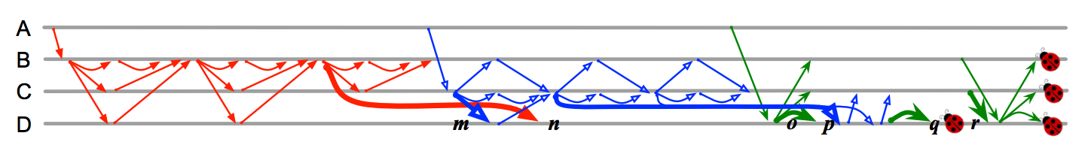
Bug depth: Minimum tuple of events to expose the bug
$d=2$ $\left\langle e_{1}, \right.\left.e_{2}\right\rangle$ e.g. order violation
$d=3$ $\left\langle e_{1}, \right.\left.e_{2}, e_{3}\right\rangle$e.g. atomicity violation
$d=n$ $\left\langle e_{1}, \right.\left.{…,e}_{n}\right\rangle$more complicated bugs
Bug in Cassandra 2.0.0 (img. from Leesatapornwongsa et. al. ASPLOS’16)

Slide 8
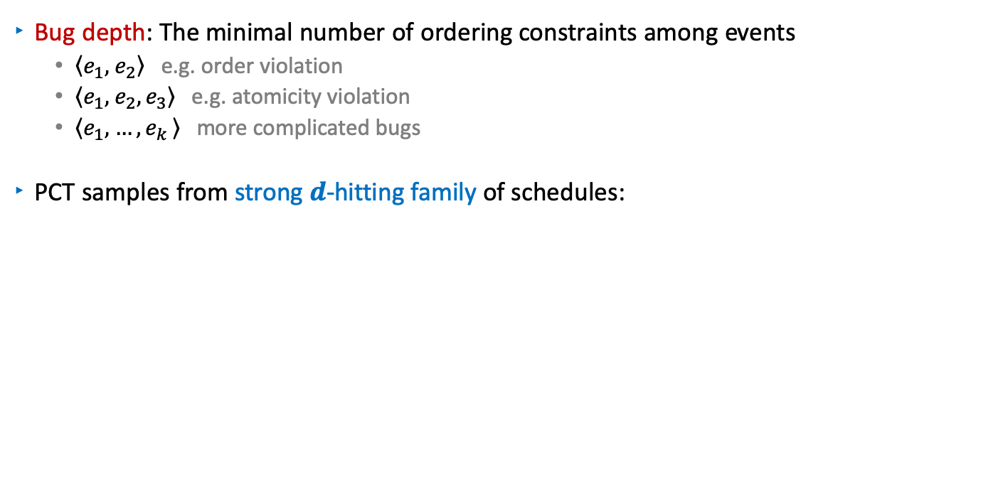
Sampling from a Depth Bounded Set of Schedules
$\text{Bug} \text{depth}\text{: }\text{The} \text{minimal} \text{number} \text{of} \text{ordering} \text{constraints} \text{among} \text{events}$
$\left\langle e_{1}, \right.\left.e_{2}\right\rangle$ e.g. order violation
$\left\langle e_{1}, \right.\left.e_{2}, e_{3}\right\rangle$e.g. atomicity violation
$\left\langle e_{1}, \right.\left.{…,e}_{k}\right\rangle$ more complicated bugs
PCT samples from strong $d$-hitting family of schedules:
n-hitting
. . .
2-hitting
family
1-hitting family
Notes:
if for all $e$: $e≥_{α}e_{i}$ implies that $e$is causally dependent on ${ e}_{j}$ for some$j≥i$

Slide 9
Coverage: Strong $d$-Hitting families of schedules
A schedule $α$strongly hits $\left\langle e_{0}, \right.\left.…, e_{d−1}\right\rangle$ if for all $e∈P$:
$e≥_{α}e_{i}$ implies $e≥e_{j}$ for some$j≥i$
$$a$$
$$b$$
$$c$$
$$α1= a, b, c, d, f, e, g$$
$$\text{strongly} \text{hits}\text{ 1−}\text{tuple} \left\langle g\right\rangle \text{, 2−}\text{tuple} \left\langle e, g\right\rangle$$
$$α2= a, b, c, d, f, g, e$$
$\text{strongly} \text{hits}\text{ 1−}\text{tuple} \left\langle e\right\rangle \text{, 2−}\text{tuple} \left\langle g, e\right\rangle$, 3-tuple $\left\langle d, g, e\right\rangle$
$$g$$
$$d$$
$$e$$
$$f$$
For each d-tuple, a strong $d$-hitting family has a schedule which strongly hits it.

Slide 10
Challenge: How to sample uniformly at random from strong $d$-hitting family for distributed systems?
Events in a distributed message passing system:
upgrowing poset, revealed during execution
Mutual dependency to the schedule
$$a$$
$$b$$
$$c$$
Build a schedule online
For an arbitrary ordering
$$d$$
$$g$$
Use combinatorial results for posets!
$$e$$
$$f$$
Schedule:
$$d$$
$$c$$
$$a$$
$$e$$
$$b$$
$$f$$
$$g$$

Slide 11
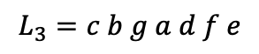
Realizer and dimension of a poset
$$a$$
$$b$$
$$c$$
Realizer of P is a set of linear orders:
$$FR = \{L1 , L2 , …, Ln\}$$
such that: $L1\bigcap{L2 … \bigcap{Ln}}=P$
Dimension of P is the minimum size of a realizer
$$d$$
$$g$$
$$e$$
$$f$$
$$L_{1}=a d e b f c g$$
Realizer of size $dim⁡(P)$
- Covers all pairwise orderings!
$$L_{2}=c a d e b g f$$
$$L_{3}=c b g a d f e$$
$$dim⁡(P) = 3$$

Slide 12
Adaptive chain covering $\sim$ Online dimension algorithm
$$a$$
$$b$$
$$c$$
Decompose P into chains
Compute linear extensions of P
$$d$$
$$g$$
C1
C2
C3
$$e$$
$$f$$
$$L1 =b a d$$
$$L1 = a$$
$$L1 = a d$$
$$L1 =b a d e$$
$$L1 =c b g f a d e$$
$$L1 =c b f a d e$$
$$L1 =c b a d e$$
$$a$$
$$b$$
$$c$$
$$L1 =c b g f a d e$$
$$L2 =c a d e b f$$
$$L2 =c a d e b$$
$$L2 =a d e b$$
$$L2 =c a d e b g f$$
$$L2 =c a d e b g f$$
$$L2 =a d b$$
$$L3 =a d e b f c g$$
$$L3 =a d e b f c$$
$$L3 =a d e b f c g$$
$$f$$
$$g$$
$$L3 =a d e b c$$
$$d$$
This is a strong 1-hitting family!
$$e$$
Adaptive chain covering $\sim$ Online dimension algorithm
[Felsner’97, Kloch’07]
Adaptive chain covering $\sim$ Strong 1-hitting family $\sim$Online dimension algorithm
[Felsner’97, Kloch’07]

Slide 13
Strong $d$-hitting family $\sim$Adaptive chain covering
[Felsner, Kloch] Strong 1-hitting family $\sim$Adaptive chain covering
$hit(w)= adapt(w)$
[Our main result] Strong $d$-hitting family $\sim$Adaptive chain covering
$hit_{d}\left(w,n\right)≤ adapt\left(w\right)\left({n \atop d−1}\right)\left(d−1\right)!$
$n$: number of events
$d$: bug depth
Index the schedules in the strong d-hitting family by:
$$\left\langle λ, n_{1},n_{2},…, n_{d−1}\right\rangle$$
strongly hits $e_{0}∈Chain(λ)$ and${ e}_{1},e2,…, e_{d−1}$
chain id
steps in which $e_{1},e_{2},…, e_{d−1}$
were added
Sample from this set of schedules!

Slide 14
PCT + Chain Partitioning
Generates randomly a schedule index $\left\langle λ, n_{1},n_{2},…, n_{d−1}\right\rangle$:
Randomly generate a $(d−1)$-tuple: $\left\langle n_{1},n_{2},…, n_{d−1}\right\rangle$
Partition P into chains online
Assign random distinct initial priorities $> d$
Reduce priority at: $\left\langle e_{1},e_{2},…, e_{d−1}\right\rangle$ to $(d−i−1)$ for $e_{i}$
strongly hits $e_{0}∈Chain(λ)$ and${ e}_{1},e2,…, e_{d−1}$
$$e_{0}$$
$$e_{3}$$
$$e_{3}$$
$$e_{2}$$
….
$$e_{2}$$
$$e_{1}$$
$$e_{1}$$
C_{k-1}
C₁
C₂
C₂
?
?
?
C_{k} $=λ$
C_{k-1}
C₁

Slide 15
Experimental results - Cassandra
 | # Event Labels (d) | Max # Events (n) | Avg of Max # Chains | Max # Chains | # Runs | #Buggy | Time(s)
Random Walk | - | 54 | 6.97 | 11 | 1000 | 0 | 481.95
PCTCP | d = 4 | 54 | 5.65 | 11 | 1000 | 0 | 505.73
PCTCP | d = 5 | 54 | 5.73 | 11 | 1000 | 1 | 503.81
PCTCP | d = 6 | 54 | 5.80 | 11 | 1000 | 1 | 512.00
Bug in Cassandra 2.0.0 (img. from Leesatapornwongsa et. al. ASPLOS’16)
Source code at: https://gitlab.mpi-sws.org/fniksic/PSharp
Source code at: https://gitlab.mpi-sws.org/burcu/pctcp-cass
Source code at: https://gitlab.mpi-sws.org/rupak/hitmc

Slide 16
Depth-Bounded + Dependency-Aware Random Testing
Strong d-hitting family
Depth-bounded set of schedules
Partial order reduction
Sample from a smaller set of schedules!

Slide 17
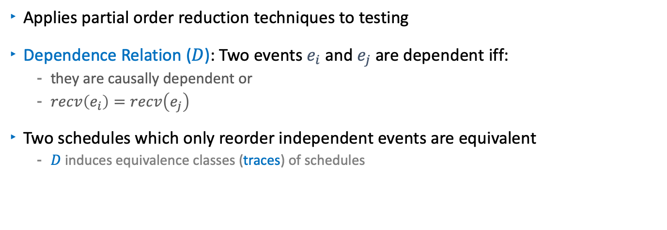
Trace Aware Random Testing
Applies partial order reduction techniques to testing
Dependence Relation ($D$): Two events $e_{i}$ and $e_{j}$ are dependent iff:
they are causally dependent or
$recv\left(e_{i}\right)=recv\left(e_{j}\right)$
Two schedules which only reorder independent events are equivalent
$D$ induces equivalence classes (traces) of schedules
n-hitting
Samples from traces
instead of schedules
. . .
2-hitting
family
1-hitting family
Trace-aware sample set
Depth-bounded sample set

Slide 18
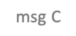
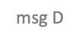

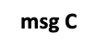
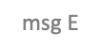

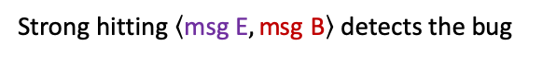
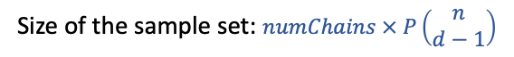
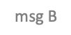


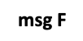
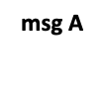
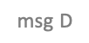



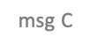


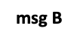


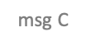
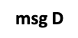
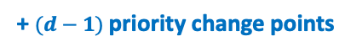
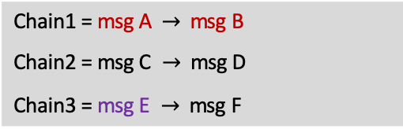



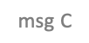

PCT is not Trace Aware
Node 1
Node 2
Node 3
Online chain partitioning
msg A
$\text{C}\text{hain}\text{1 = }\text{msg} \text{A}$ $→$ $\text{msg} \text{B}$
$\text{C}\text{hain}\text{2 = }\text{msg} \text{C} →$ $\text{msg} \text{D}$
$\text{Chain}\text{3}\text{ = }\text{msg} \text{E} →$ $\text{msg} \text{F}$
msg B
msg C
+ $(d−1)$ priority change points
Initial random priorities
msg D
$$\text{priority}\text{(}\text{Chain}\text{1) > }\text{priority}\text{(}\text{Chain}\text{2) > }\text{priority}\text{(}\text{Chain}\text{3}\text{)}$$
msg E
msg F
Select $(d−1)=1$ event to change priority
$$\text{msg} \text{C}$$
$$\text{msg} \text{D}$$
$$\text{msg} \text{E}$$
$$\text{msg} \text{F}$$
$$\text{msg} \text{A}$$
$$\text{msg} \text{B}$$
$$\text{msg} \text{A}$$
$$\text{msg} \text{C}$$
$$\text{msg} \text{D}$$
$$\text{msg} \text{E}$$
$$\text{msg} \text{F}$$
$$\text{msg} \text{B}$$
$$\text{msg} \text{A}$$
$$\text{msg} \text{B}$$
$$\text{msg} \text{E}$$
$$\text{msg} \text{F}$$
$$\text{msg} \text{C}$$
$$\text{msg} \text{D}$$
Buggy if: … msg A … msg E … msg B
$$\text{msg} \text{A}$$
$$\text{msg} \text{B}$$
$$\text{msg} \text{C}$$
$$\text{msg} \text{E}$$
$$\text{msg} \text{F}$$
$$\text{msg} \text{D}$$
Strong hitting $\left\langle \text{msg} \text{E}, \text{msg} \text{B}\right\rangle$ detects the bug
$$\text{msg} \text{A}$$
$$\text{msg} \text{B}$$
$$\text{msg} \text{C}$$
$$\text{msg} \text{D}$$
$$\text{msg} \text{E}$$
$$\text{msg} \text{F}$$
$$\text{msg} \text{A}$$
$$\text{msg} \text{B}$$
$$\text{msg} \text{C}$$
$$\text{msg} \text{D}$$
$$\text{msg} \text{E}$$
$$\text{msg} \text{F}$$
Size of the sample set: $numChains × P\left(\begin{matrix}n \\ d−1\end{matrix}\right)$
Can we exploit POR techniques?

Slide 19
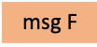
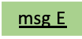
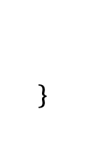
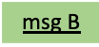
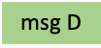
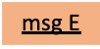
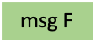
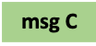
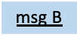
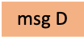
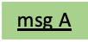
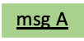
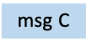
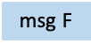
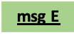
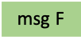
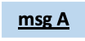

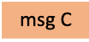
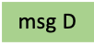
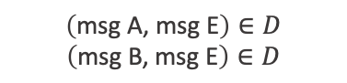
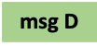










Trace Aware Random Testing
Node 1
Node 2
Node 3
Need to explore only the orderings of
dependent and co-enabled (racy) events!
msg A
msg B
$$\left(\text{msg} \text{A}\text{, }\text{msg} \text{E}\right)∈D$$
$$\left(\text{msg} \text{B}\text{, }\text{msg} \text{E}\right)∈D$$
msg C
msg D
Traces for the set of schedules:
msg E
$$\text{msg} \text{C}$$
$$\text{msg} \text{D}$$
$$\text{msg} \text{E}$$
$$\text{msg} \text{F}$$
$$\text{msg} \text{A}$$
$$\text{msg} \text{B}$$
Trace[E, A, B]
msg F
Trace[A, E, B]
$$\text{msg} \text{A}$$
$$\text{msg} \text{C}$$
$$\text{msg} \text{D}$$
$$\text{msg} \text{E}$$
$$\text{msg} \text{F}$$
$$\text{msg} \text{B}$$
$$\text{msg} \text{A}$$
$$\text{msg} \text{B}$$
$$\text{msg} \text{E}$$
$$\text{msg} \text{F}$$
$$\text{msg} \text{C}$$
$$\text{msg} \text{D}$$
$$\text{msg} \text{A}$$
$$\text{msg} \text{B}$$
$$\text{msg} \text{E}$$
$$\text{msg} \text{F}$$
$$\text{msg} \text{C}$$
$$\text{msg} \text{D}$$
Trace[A, B, E]
$$\text{msg} \text{A}$$
$$\text{msg} \text{B}$$
$$\text{msg} \text{C}$$
$$\text{msg} \text{D}$$
$$\text{msg} \text{E}$$
$$\text{msg} \text{F}$$
Buggy if: … msg A … msg E … msg B
$$\text{msg} \text{A}$$
$$\text{msg} \text{B}$$
$$\text{msg} \text{C}$$
$$\text{msg} \text{D}$$
$$\text{msg} \text{E}$$
$$\text{msg} \text{F}$$
Characterize the sample set in a way that it avoids redundant executions

Slide 20

























































taPCT: Trace Aware PCT
Node 1
Node 2
Node 3
Online chain partitioning
msg A
$\text{C}\text{hain}\text{1 = }\text{msg} \text{A}$ $→$ $\text{msg} \text{B}$
$\text{C}\text{hain}\text{2 = }\text{msg} \text{C} →$ $\text{msg} \text{D}$
$\text{Chain}\text{3}\text{ = }\text{msg} \text{E} →$ $\text{msg} \text{F}$
msg B
msg C
+ $(d−1)$ priority change points
Initial random priorities
msg D
$$\text{priority}\text{(}\text{Chain}\text{1) > }\text{priority}\text{ (}\text{Chain}\text{2) > }\text{priority}\text{ (}\text{Chain}\text{3}\text{)}$$
msg E
msg F
Trace-aware selection of (d-1) events
$$\text{msg} \text{C}$$
$$\text{msg} \text{D}$$
$$\text{msg} \text{E}$$
$$\text{msg} \text{F}$$
$$\text{msg} \text{A}$$
$$\text{msg} \text{B}$$
$$\text{msg} \text{A}$$
$$\text{msg} \text{C}$$
$$\text{msg} \text{D}$$
$$\text{msg} \text{E}$$
$$\text{msg} \text{F}$$
$$\text{msg} \text{B}$$
$$\text{msg} \text{A}$$
$$\text{msg} \text{B}$$
$$\text{msg} \text{E}$$
$$\text{msg} \text{F}$$
$$\text{msg} \text{C}$$
$$\text{msg} \text{D}$$
$$\text{msg} \text{A}$$
$$\text{msg} \text{B}$$
$$\text{msg} \text{C}$$
$$\text{msg} \text{D}$$
$$\text{msg} \text{E}$$
$$\text{msg} \text{F}$$
Buggy if: … msg A … msg E … msg B
$$\text{msg} \text{A}$$
$$\text{msg} \text{B}$$
$$\text{msg} \text{E}$$
$$\text{msg} \text{F}$$
$$\text{msg} \text{C}$$
$$\text{msg} \text{D}$$
$$\text{msg} \text{A}$$
$$\text{msg} \text{B}$$
$$\text{msg} \text{E}$$
$$\text{msg} \text{F}$$
$$\text{msg} \text{C}$$
$$\text{msg} \text{D}$$
taPCT prunes out the schedules which strongly hits
msg C, msg D, and msg F
$$\text{msg} \text{A}$$
$$\text{msg} \text{B}$$
$$\text{msg} \text{E}$$
$$\text{msg} \text{F}$$
$$\text{msg} \text{C}$$
$$\text{msg} \text{D}$$
Strong hitting $\left\langle \text{msg} \text{E}, \text{msg} \text{B}\right\rangle$ detects the bug
$$\text{msg} \text{A}$$
$$\text{msg} \text{B}$$
$$\text{msg} \text{C}$$
$$\text{msg} \text{D}$$
$$\text{msg} \text{E}$$
$$\text{msg} \text{F}$$
Size of the sample set: $numChains × P\left(\begin{matrix}\hat{n} \\ d−1\end{matrix}\right)$
$$\text{msg} \text{A}$$
$$\text{msg} \text{B}$$
$$\text{msg} \text{C}$$
$$\text{msg} \text{D}$$
$$\text{msg} \text{E}$$
$$\text{msg} \text{F}$$
$$\text{msg} \text{A}$$
$$\text{msg} \text{B}$$
$$\text{msg} \text{C}$$
$$\text{msg} \text{D}$$
$$\text{msg} \text{E}$$
$$\text{msg} \text{F}$$
where $\hat{n}$ is the number of racy events

Slide 21



Experimental Results – Cassandra
Sampler | # Event Labels (d) | # Trace | min | max | dev | #Runs | #Buggy
Random Walk | - | 992 | 1 | 4 | 1.01 | 1000 | 0
RAPOS | - | 994 | 1 | 2 | 1.01 | 1000 | 0
POS | - | 1000 | 1 | 1 | 1.00 | 1000 | 0
d-POS | d = 4 | 998 | 1 | 2 | 1.00 | 1000 | 0
 | d = 5 | 1000 | 1 | 1 | 1.00 | 1000 | 0
 | d = 6 | 1000 | 1 | 1 | 1.00 | 1000 | 1
PCT | d = 4 | 876 | 1 | 4 | 1.14 | 1000 | 0
 | d = 5 | 904 | 1 | 4 | 1.11 | 1000 | 1
 | d = 6 | 915 | 1 | 5 | 1.09 | 1000 | 1
taPCT | d = 4 | 877 | 1 | 6 | 1.14 | 1000 | 1
 | d = 5 | 896 | 1 | 9 | 1.12 | 1000 | 3
 | d = 6 | 903 | 1 | 7 | 1.11 | 1000 | 3
Sampling from
all executions
Sampling from
$d$-bounded sets
of executions
Akka Microbench:
http://gitlab.mpi-sws.org/burcu/akkamicrobench
Zookeeper:
http://gitlab.mpisws.org/rupak/hitmc/tree/develop/HitMC
Cassandra:
http://gitlab.mpi-sws.org/burcu/pctcp-cass/tree/taPCT

Slide 22
Experimental results - ZooKeeper
Start(1)
Start(2)
Start(3)
Msg(1,1)
Crash(1)
Msg(2,1)
Crash(2)
Msg(3,1)
Crash(3)
Msg(1,2)
Start(2)
Msg(1,3)
Msg(2,1)
Crash(2)
Msg(1,1)
Msg(2,2)
Source code at: https://gitlab.mpi-sws.org/fniksic/PSharp
Source code at: https://gitlab.mpi-sws.org/burcu/pctcp-cass
Source code at: https://gitlab.mpi-sws.org/rupak/hitmc

Slide 23
(Most) Related work for sampling algorithms
PCT: Probabilistic Concurrency Testing [Burckhardt et al. 2010]
Applies to multithreaded programs
Generalization to
any partial order of events
POS: Partial Order Sampling [Yuan et al. 2018]
PCT(CP): Probabilistic Concurrency Testing
with Chain Partitioning
Samples from traces, trace aware
+ depth bounding
+ trace awareness
d-POS: Depth Bounded POS
taPCT: Trace Aware PCT
Depth bounded and trace aware
Depth bounded and trace aware
Utilizes chain partitioning – smaller sample set size

Slide 24
How to detect bugs?
. . . . . . . .
. . . . . . . . .
. . . . . . . . . . . . . . . . . . . . . . . . .
. . . . . . . .
. . . . . . . .
. . . . . . . . . . .
. . . . . . . . . . .
Systematic testing - infeasible
Random testing – no guarantees
e.g. PCT, taPCT (with theoretical guarantees)
e.g. Jepsen, ChaosMonkey

Slide 25
Randomized Testing with Jepsen
Test tool for safety of distributed databases, queueing systems, consensus systems etc.
Black-box testing by randomly inserting network partition faults
Developed by Kyle Kingsbury, available open-source
Approach:
Generate random client operations
Record history
Verify that history is consistent with respect to the model

Slide 26
Example: Jepsen Analysis for MongoDB
MongoDB is a document-oriented database
Primary node accepting writes and async replication to other nodes
Test scenario:
5 nodes, n1 is primary
Split into two partitions (n1, n2 and n3, n4, n5), n5 becomes new primary
Heal the partition

Slide 27
How many writes get lost?
In Version 2.4.1. (2013)
Writes completed 93.608 seconds 6000 total 5700 acknowledged 3319 survivors 2381 acknowledged writes lost!
Even when imposing writes to majority:
6000 total 5700 acknowledged 5701 survivors 2 acknowledged writes lost! 3 unacknowledged writes found!
In Version 3.4.1 all tests are passed (when using the right configuration with majority writes and linearizable reads) !!

Slide 28
Why Is Random Testing Effective for Partition Tolerance Bugs? (Majumdar & Niksic, 2018)
Tests and goal coverage:
Covering family = Set of tests cover all goals
Small covering families = Efficient testing
(from Filip Niksic’s presentation @ POPL’18)
Notes:
https://www.youtube.com/watch?v=g5cehS7ZSJ8
A theoretical understanding for the empirical success of Jepsen

Slide 29
Why Is Random Testing Effective for Partition Tolerance Bugs? (Majumdar & Niksic, 2018)
Random Testing
(from Filip Niksic’s presentation @ POPL’18)
Notes:
A theoretical understanding for the empirical success of Jepsen

Slide 30
Why Is Random Testing Effective for Partition Tolerance Bugs?
Let G be the set of goals and P[random T covers G ] ≥ p
Theorem: There exists a covering family of size p⁻¹ log|G|.
P[ random T does not cover G ] ≤ 1 – p
P[ K independent T do not cover G ] ≤ (1 - p)^{K}
P[ K independent T are not a covering family ] ≤ |G| (1 - p)^{K}
For K = p⁻¹ log|G|, this probability is strictly less than 1.
Therefore, there must exist K tests that are a covering family!
(from Filip Niksic’s presentation @ POPL’18)

Slide 31
Why Is Random Testing Effective for Partition Tolerance Bugs? (Majumdar & Niksic, 2018)
Coverage notions for network partitions:
k-Splitting
Split network into k distinct blocks (typically k = 2 or k = 3)
(k,l)-Separation
Split subsets of nodes with specific role
Minority isolation
Constraints on number of nodes in a block (e.g. leader is in the smaller block of a partition)
With high probability, O(log n) random partitions simultaneously
provide full coverage of partitioning schemes that incur typical bugs.

Slide 32
ChaosMonkey
Unleash a wild monkey with a weapon in your data center (or cloud region) to randomly shoot down instances and chew through cables¹
Built by Netflix in 2011 during their cloud migration
Testing for fault-tolerance and quality of service in turbulent situations
Random selection of instances in the production environment and deliberately put them out of service
Forces engineers to built resilient systems
Automation of recovery
¹ http://principlesofchaos.org

Slide 33
Principles of Chaos Engineering²
Discipline of experimenting on a distributed system in order to build confidence in the system’s capability to withstand turbulent conditions in production
Focus on the measurable output of a system, rather than internal attributes of the system
Throughput, error rates, latency percentiles, etc.
Prioritize disturbing events either by potential impact or estimated frequency.
Hardware failures (e.g. dying servers)
Software failures (e.g. malformed messages)
Non-failure events (e.g. spikes in traffic)
Aim for authenticity by running on production system
But reduce negative impact by minimizing blast radius
Automatize every step
² http://principlesofchaos.org

Slide 34
The Simian Army³
Shutdown instance. Shuts down the instance using the EC2 API. The classic chaos monkey strategy.
Block all network traffic. The instance is running, but cannot be reached via the network
Detach all EBS volumes. The instance is running, but EBS disk I/O will fail.
Burn-CPU. The instance will effectively have a much slower CPU.
Burn-IO. The instance will effectively have a much slower disk.
Fill Disk. This monkey writes a huge file to the root device, filling up the (typically relatively small) root disk.
³ https://github.com/Netflix/SimianArmy/wiki/The-Chaos-Monkey-Army

Slide 35
The Simian Army (cont.)
Kill Processes. This monkey kills any java or python programs it finds every second, simulating a faulty application, corrupted installation or faulty instance.
Null-Route. This monkey null-routes the 10.0.0.0/8 network, which is used by the EC2 internal network. All EC2 <-> EC2 network traffic will fail.
Fail DNS. This monkey uses iptables to block port 53 for TCP & UDP; those are the DNS traffic ports. This simulates a failure of your DNS servers.
Network Corruption. This monkey corrupts a large fraction of network packets.
Network Latency. This monkey introduces latency (1 second +- 50%) to all network packets.
Network Loss. This monkey drops a fraction of all network packets.

Slide 36
Summary - Random Testing of Distributed Systems:
Randomized testing methods PCTCP and taPCT with probabilistic guarantees
Jepsen testing framework
Random testing is effective for partition tolerance bugs
ChaosMonkey
Failure testing on production environment
taPCT: depth-bounded + trace aware + theoretical guarantees

